Slide 1
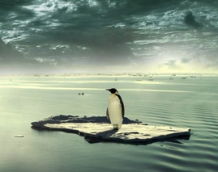

The climate crisis
Qinmei Yao
Student No:21901010
School of economics
March 23 ,2020

Slide 2

content:
一、The current state of the climate crisis
二、Attitudes towards the climate crisis
三、 Global action on the climate crisis

Slide 3
一、The current state of the climate crisis

Slide 4
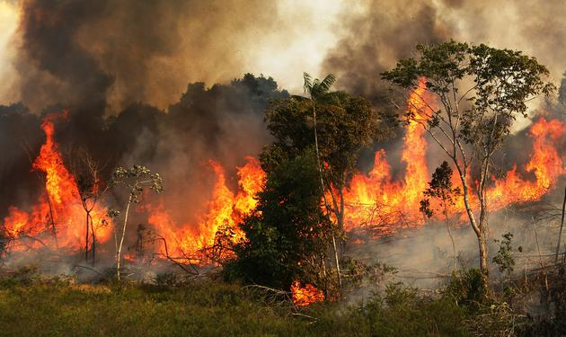
1、Amazon fire
Lasting more than 25 days
More than one million hectares
Spreading to 3,000 kilometers away

Slide 5
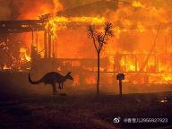

2、Australian fire
More than 400 hectares
Lasting 210 days
killing at least 33 people
Burning more than 2,500 houses
Destroying 11.7 million hectares of land

Slide 6
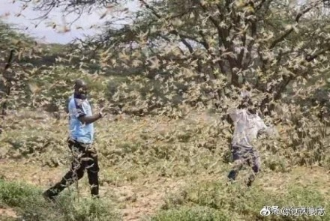
3、Locust plague
Covering 10 countries
From West Africa to East Africa
From West Asia to East Asia
Travelling 150 kilometers a day
Wiping out about 35,000 people's food

Slide 7
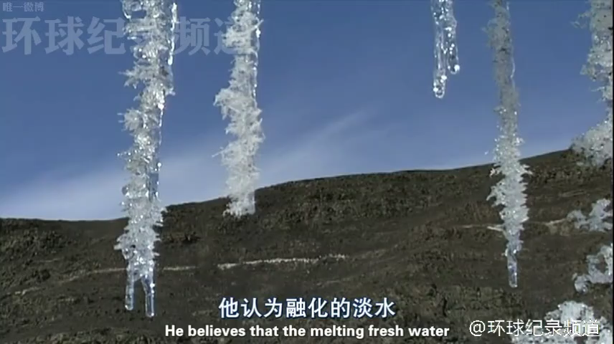
Video：Climate problem
Global record channel

Slide 8
二、Attitudes towards the climate crisis

Slide 9
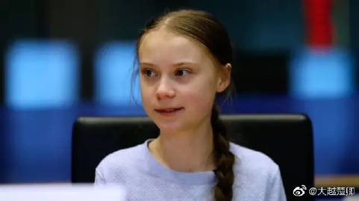
1、“Green girl"
Sweden's "green girl" Greta Tumberg
ending to investments in fossil fuel exploration

Slide 10
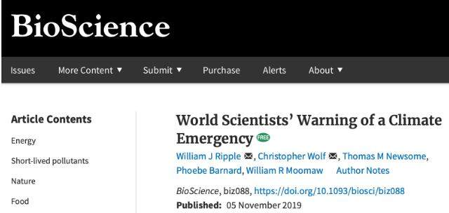
2、Scientists
Warning the world is facing a climate crisis.

Slide 11
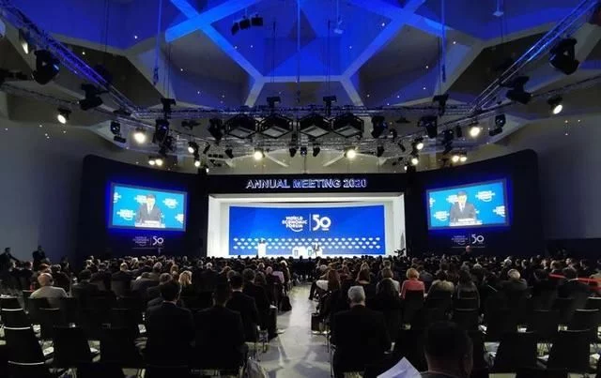
3、World Economic Forum
Consequences of not addressing the climate crisis far exceeds costs

Slide 12
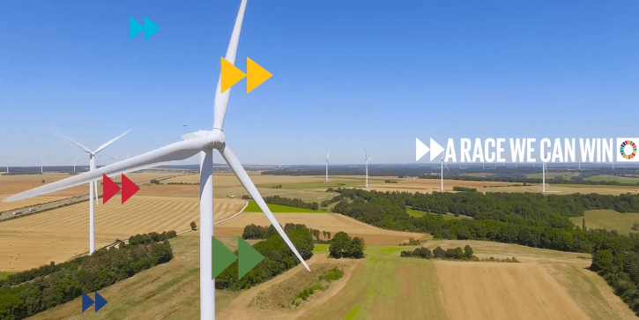
4、United Nations
Speeding up the implementation of the Paris Agreement

Slide 13
三、 Global action on the climate crisis

Slide 14
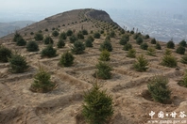
Tree-planting
Reforestation can reduce carbon dioxide emissions
It has little effect

Slide 15
From focusing on "controlling“ to "expanding"

Slide 16
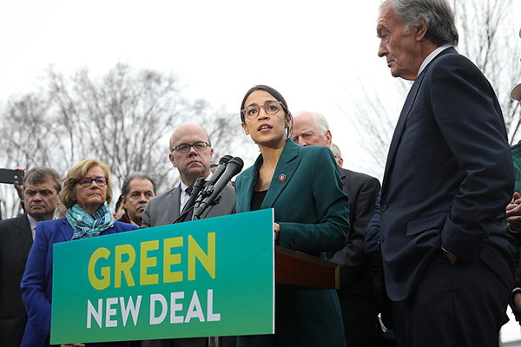
1、The United States
Democratic Representative Alexander·Ocasio·Cortez proposed "Green New Deal"
Purposes:
Promoting the development of renewable industries
Creating "millions" of quality employment opportunities

Slide 17
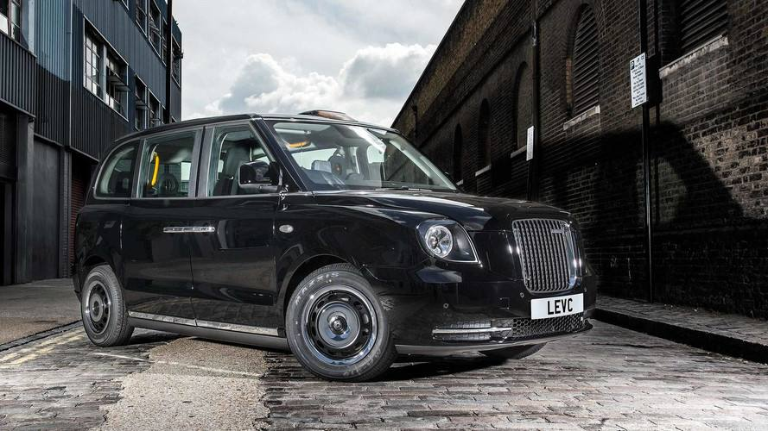
2、England
The British Labour Party proposed "green industrial revolution"
Combining government-driven economic transformation and social justice.

Slide 18
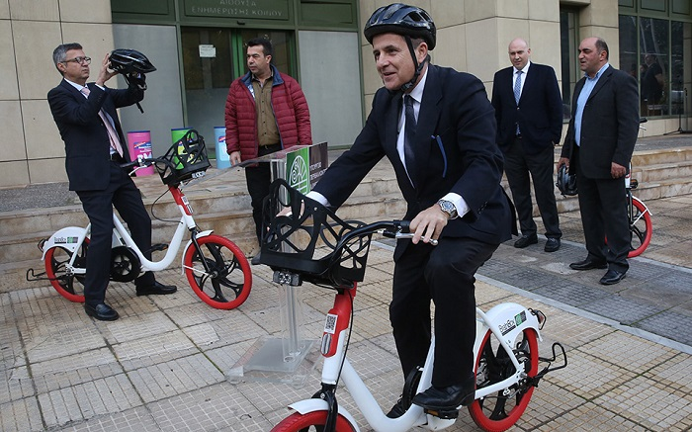
3、Greece
Former Greek Finance Minister proposed “international green new deal”.
Launching first official electric vehicles and electric bicycles

Slide 19
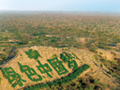
4、China
Non-fossil energy accounts for 14.3%
Renewable energy installed capacity accounts for 30% of the world ’s total
New energy vehicle ownership accounts for more than half of the world.
the largest investment in renewable energy.
Green Chinese Dream
Data source：“China's Policies and Actions on Climate Change 2019 Annual Report”

Slide 20
Thank you for your attention!

